Slide 1
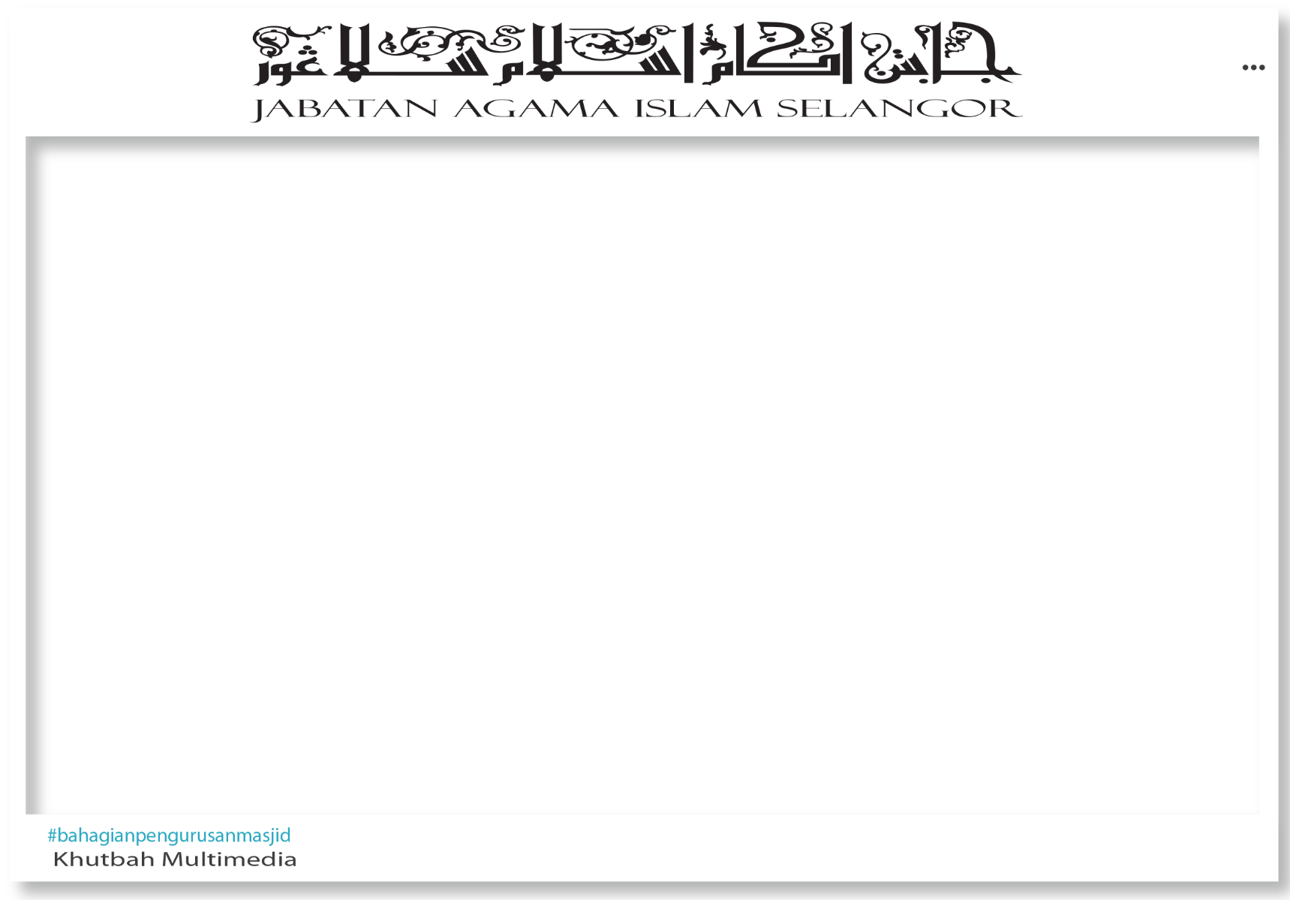

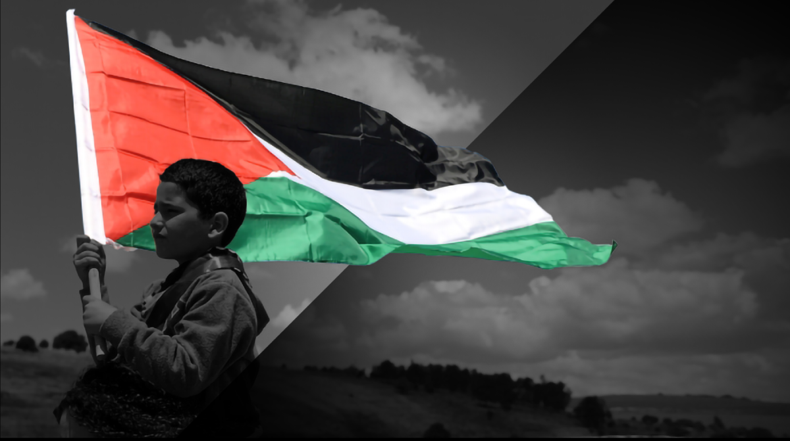
WISDOM AND LESSONS FROM THE PLIGHT
OF THE PALESTINIANS

Slide 2

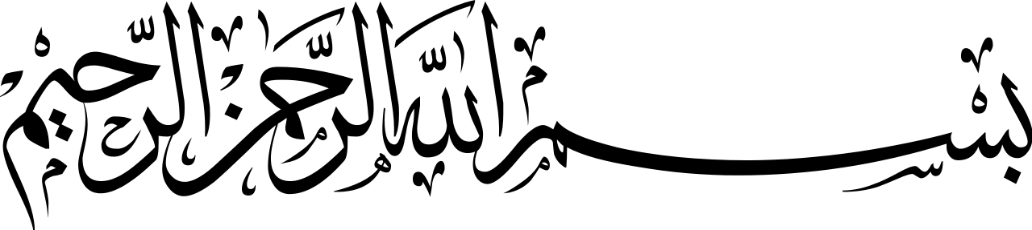
I humbly implore upon all of us to altogether strive in increasing our taqwa of Allah Subhaanahu Wa Ta‘aala by performing all of His Commands and leaving out all of

Slide 3
His prohibitions. Let us give our full attention to the sermon that is to be delivered. Do not chit chat and fiddle with our mobile phones. May this khutbah benefit all of us.

Slide 4

Today, I will be expounding upon a khutbah titled
WISDOM AND LESSONS FROM THE PLIGHT
OF THE PALESTINIANS

Slide 5
It’s very disheartening to see, what more to endure through such adversity. Such severity of the trial afflicting the Palestinians that it is very difficult to describe. The Palestinians have long

Slide 6
lived under the occupation of the Israeli regime. Throughout their lives, the Palestinians have been persecuted and oppressed in many aspects of life such as the freedom to move

Slide 7
about, the rights to earn a living, the rights to own land and dwelling. The occupation and destruction of properties, as well as

Slide 8
the construction of illegal settlements by the Israeli regime in Palestine, specifically in the West Bank and Gaza, have all been planned and systematically carried out. However,

Slide 9
in comprehending this conflict, there are wisdom and lessons for the Muslim ummah in pondering upon this matter thoroughly and comprehending the hikmah (wisdom) behind

Slide 10
this tragedy. The following are several ‘ibrah (lesson or wisdom) and lessons that can be derived from the ongoing conflict in Palestine:

Slide 11
1. The main wisdom and lesson from the invasion that took place in the land of Palestine is the very need for the Muslim ummah to unite, cooperate, achieving unanimous agreement,

Slide 12
and mutually aiding one another for unity leads to strength, development, and blessings upon the Muslim ummah. Islam forbids its adherents from being divided, getting into conflict,

Slide 13
quarreling, for it all will cause destruction upon a civilization, as well as diminishing the Muslim identity. The Muslim ummah must build its strength in competing within aspects of

Slide 14
physical, spiritual, skills, military prowess, economics, including aspects of science and modern technological inventions. All of these must be pursued so that the Muslim ummah will

Slide 15
have strength, dignity, self-worth, and respected by friends and foes without having to remain dependent upon the West. All of these can be implemented if the Muslims are united and

Slide 16
firmly cling upon the religion of Allah in facing various tribulations and challenges. Allah Subhaanahu Wa Ta‘aala mentions in verse 103 of Soorah Aal ‘Imraan:

Slide 17
“And hold firmly to the rope of Allah all together and do not become divided. And remember the favor of Allah upon you -

Slide 18
when you were enemies and He brought your hearts together and you became, by His favor, brother.”

Slide 19
2. The Muslim ummah must always have tawakkul (full reliance in Allah) and do not even once despair from the rahmah (mercy) of Allah. Allah Subhaanahu Wa Ta‘aala mentions in

Slide 20
verse 53 of Soorah az-Zumar:
“...do not despair of the mercy of Allah. Indeed, Allah forgives all sins. Indeed, it is He who is the Forgiving, the Merciful.”

Slide 21
From among the great lessons that we can emulate from the tragedy that befell the Palestinians is their very demeanor in truly having genuine tawakkul in Allah, and surrendering

Slide 22
all of the matters regarding their statehood and livelihood to Allah. Even though they endure tribulations that are very challenging in this world, the Palestinians continue to remain resilient and

Slide 23
poise in their fight to defend their homeland and their families, while at the same time they would fully submit to the will of Allah in determining what the future holds for them.

Slide 24
They are entitled to be given full justice and live freely on this earth. Likewise, the unity of brotherhood that is potent demonstrated by the Palestinitians even though there are political

Slide 25
differences among them. The constant oppression upon them have groomed the Palestinians to become persistent, resilient, and continue to rise in fighting the injustices endured.

Slide 26
3. We as Malaysians must be truly grateful for the peacefulness that we are enjoying in our nation all these while. Just like citizens of other nations, the Palestinians also desire for peace and

Slide 27
yearn for a sovereign state. This desire serves as the motivational source for the Palestinians to remain determined in fighting for a nation that is liberated and sovereign.

Slide 28
4. The steadfastness and spiritual strength of the Palestinians manifests extraordinary endurance in facing resistance and difficulties in facing the continuous advancement of the enemy’s onslaught.

Slide 29
The strength and spirit of the Palestinians in remaining istiqaamah while continuing to fight, even though they are in a very difficult situation without food and drinks, let alone basic amenities,

Slide 30
is a great lesson that can motivate the resiliency of the Muslim ummah. Such resilience necessitates solid imaan (faith), unwavering belief in the power of Allah, patience, strong spiritual and

Slide 31
mental endurance, and diligence fighting in the path of Allah. Without diligence, the spiritual and mental strength of the Palestininans would probably be unable to sustain and attain success.

Slide 32
5. In addition, the support and solidarity from all quarters upon the humanitarian crisis has opened up the eyes of the world to witness the actual truth. This conflict has attracted the

Slide 33
attention of leaders and the world community from various nations to fight against oppression. The full unconditional support of the West towards Israel manifests their double standard

Slide 34
upon humanitarian rights that they often brag. Therefore, the Muslims must remain weary of the philosophy of human rights that are espoused by the Western world, so as to not be entrapped by

Slide 35
the scheming and planning that marginalizes the rights of the Palestinians. It is even more saddening when many within the Muslim ummah are

Slide 36
fascinated and captivated with the Western philosophy of human rights that confuses the Muslim ummah.

Slide 37
As believers, let us take full responsibility in offering aid and material and spiritual contributions such as resources, ideas, monies, as well as continuous supplication with the

Slide 38
hope that Allah will answer our prayers, so that one day the Palestinians will taste victory and independence from the vicious grip of the Israeli Zionists. No matter how

Slide 39
small the contribution and du‘aa (supplication) from us, surely it will inject passion into the spirit of the Palestinians to continue their fight in upholding the truth and defending their land.

Slide 40
The victory for the Muslim ummah is a surety, and the losses incurred by the oppressors are also a surety. Only Allah Alone knows when all these will take place. With that in mind, let us altogether:

Slide 41
1. Continue to remain istiqaamah in supplicating and beseeching Allah Subhaanahu Wa Ta‘aala so that the Palestinians will be bestowed with perseverance, patience,

Slide 42
and spiritual strength in liberating their homeland from the grip of Israeli Zionists. In the hadeeth of Anas bin Maalik radiyAllaahu ‘anh, Rasulullah ﷺ said:

Slide 43
“Help your brother whether he is an oppressor or an oppressed.”
(al-Bukhaari)

Slide 44
In this hadeeth, we are well aware that Rasulullah ﷺ had commanded us to aid those that are being oppressed and persecuted.

Slide 45
2. To spread the news and information regarding the brutality of the Israeli regime in social media outlets and ward off the propaganda and false news being propagated by pro-Israeli

Slide 46
media that conceals the actual truth. This is because the propaganda being played out by the Israeli Zionists depicts them as being the victim of oppression. As Muslims, truth and justice

Slide 47
must be highlighted and it is this truth that will be attained in the end, in defeating falsehood. As Muslims, we must have certainty in the promises of Allah mentioned in al-Qur’an that those who

Slide 48
are oppressive and opposes the truth will fail in the end.
3. To continue performing Qunoot Naazilah during every obligatory prayer for it is the Sharee‘ah of

Slide 49
Allah, moreover it is a shi‘aar (symbol) of the unity of Islamic brotherhood. If we truly sympathize with the plight of our Muslim brethren that are being oppressed, then please

Slide 50
help them. Physical distance is never a barrier for us to provide aid. Though hindered, none can block off the most potent weapon of the Muslim ummah, which is du‘aa. Moreover,

Slide 51
the Sharee‘ah of Allah will remain perfect and complete throughout time. In the future, we will find tribulations and tragedies that would befall upon the Muslim ummah. This is no

Slide 52
assumption or prediction but it is the reality that was firmly stated by Rasulullah in the narration of Abu Hurayrah radiyAllaahu ‘anh:

Slide 53
“Time will pass rapidly, good deeds will decrease, and miserliness will be thrown (in the hearts of the people),

Slide 54
and there will be much al-Harj.” They asked, “What is al-Harj?” He replied, “Killing! Killing!”
(al-Bukhaari)

Slide 55
Similarly, we must be very concerned for there is the possibility of war spreading to nearby nations. This can trigger a larger and more widespread war. Its effect would be that hatred

Slide 56
among mankind will intensify and difficult to be curbed due to differences in intellectual ideologies and understanding in the future.

Slide 57
To end the khutbah, let us altogether derive lessons and internalizations as guidance and guidelines for us. Among them:

Slide 58
1. The Muslim ummah must have patience and beseech Allah in every trials decreed by Allah Subhaanahu Wa Ta‘aala.

Slide 59
2. We must be cognizant of the fact that the Palestinians have long lived under Israeli occupation. They were tortured and oppressed in many

Slide 60
aspects of their lives such as the freedom of movement, seeking livelihood, and owning land and dwelling.

Slide 61
“And their words were not but that they said, “Our Lord, forgive us our sins and the excess [committed] in our affairs and plant

Slide 62
firmly our feet and give us victory over the disbelieving people.””
(Soorah Aal ‘Imraan 3:147)

Slide 63
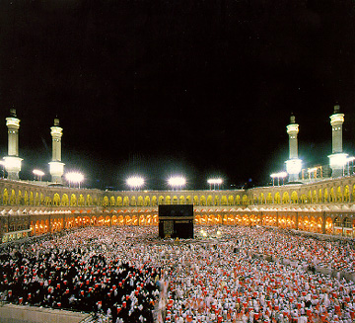

THE SECOND KHUTBAH

Slide 64

Let us altogether strive to have the taqwa of Allah Subhaanahu Wa Ta‘aala by increasing our obedience towards Him and avoiding acts of disobedience and abominable deeds.

Slide 65
O Allah! Make us among Your slaves that fulfills the amaanah. Strengthen our imaan so that we avoid treachery, protect us from becoming among those that neglect their responsibilities,

Slide 66
and protect our state and nation from destruction due to bribery. Render the duty to lead our country upon Your slaves whom are trustworthy and honest, as well as firm and courageous in upholding

Slide 67
the truth and executing justice according to the Sharee‘ah. O Allah, make the masaajid and suraus in the state of Selangor as Your peaceful homes,

Slide 68
uniting everyone, and serve as the heart of the ummah’s strength.

Slide 69
O Allah, O our Lord! Save our Muslim brethren whom are oppressed in the land of Palestine, and wherever they may be. O Allah! Love them and have mercy upon them, remove them from the

Slide 70
oppression and hardship that they have endured this while. O Allah! By Your Might, O Allah, accept our struggles and prayers as the reason for You to return their lands that was illegally taken.

Slide 71
Remove all the tyranny that exist on this earth. Bestow justice upon those that have been mistreated and oppressed.

Slide 72
O Allah! Grant victory upon our Muslim brethren in Palestine. Bestow upon the Muslim fighters, as well as the Palestinians, strength and patience in enduring the cruelty of the enemy.

Slide 73
O Allah! Restore peace in the land of Palestine and return the land to the Muslims.

Slide 74





